Slide 1

NMFS PIT tag based adult conversion rate estimate methodology
West Coast
Region
Blane Bellerud Ph.D.
January 22, 2024

Slide 2

OBJECTIVES FOR ESTIMATING ADULT UPSTREAM SURVIVAL
Adaptive Management: Detect changes in adult upstream survival
BiOp Adult upstream survival standards monitoring
CRS BiOp analysis and baseline
More detailed explorations of survival and

Slide 3
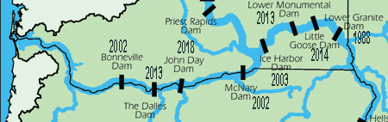
The Columbia basin has unique advantages for estimating upstream survival
Series of high efficiency detectors (97-100%) along reaches of primary interest, BON to MCN, MCN to LGR, BON to LGR

Slide 4
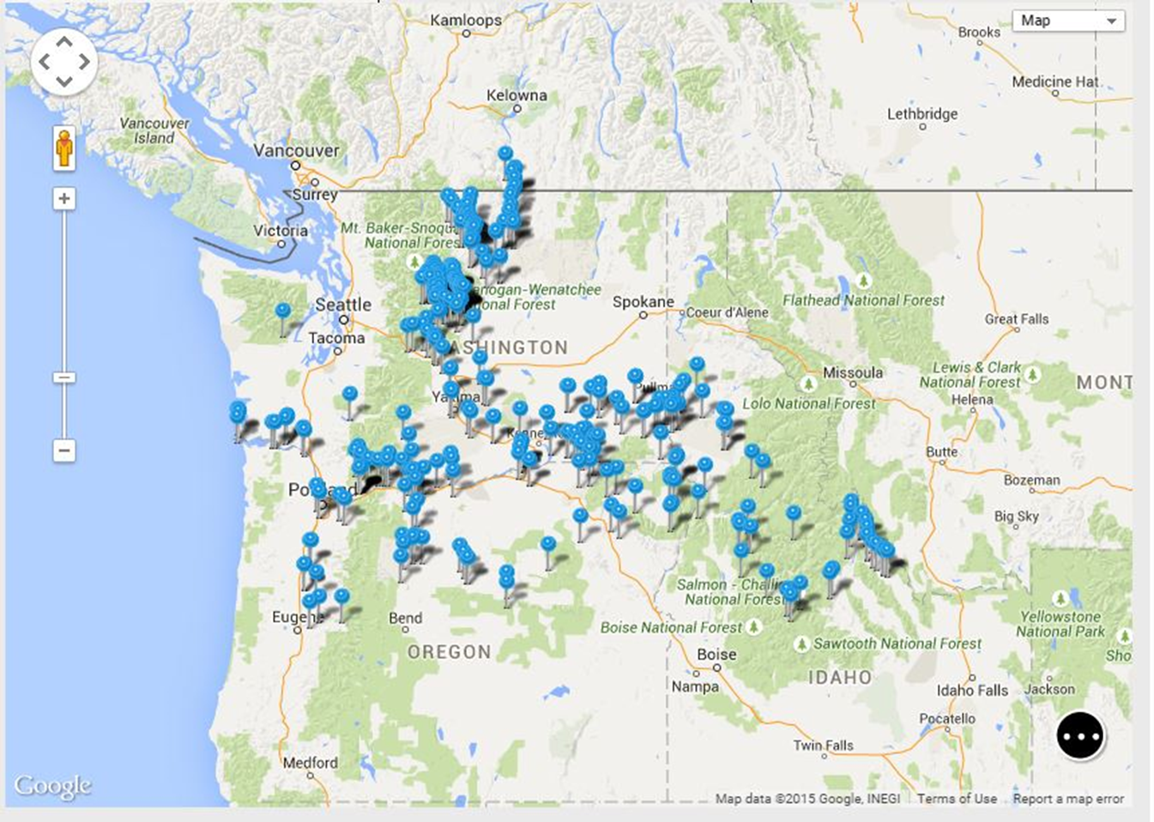
PTAGIS database and Columbia Basin PIT tag network

Slide 5
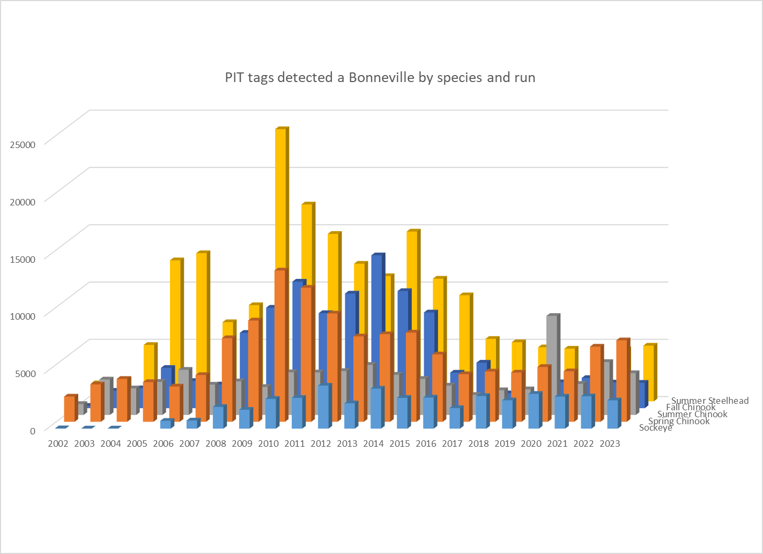
Large numbers of known origin PIT tagged adults arriving at Bonneville Dam every year

Slide 6
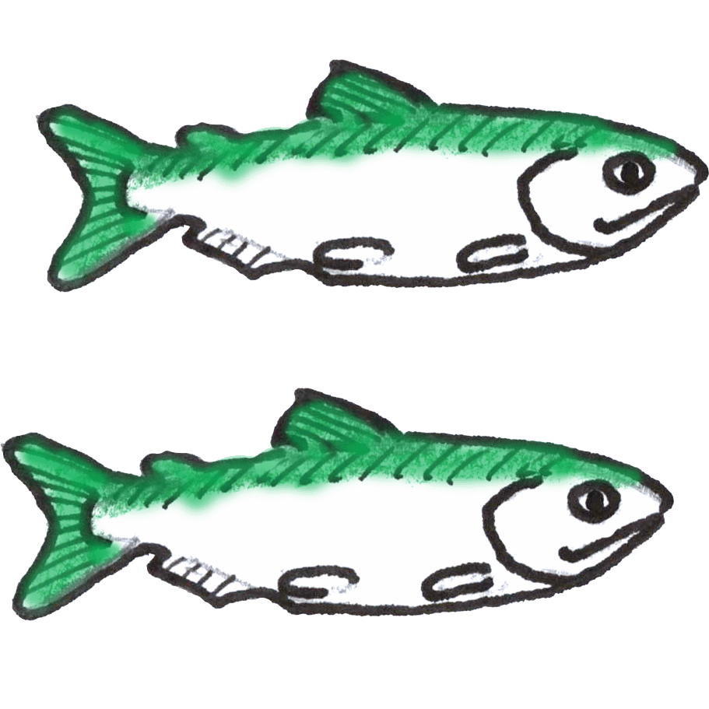
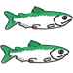
Methodology used in adult survival estimates The “Binomial” method
#upstream / # downstream = conversion estimate
Conversion = survival x detection probability
Since ladder detectors are 97-100% efficient, conversion is a good estimate of survival
Key Assumption: All fish expected to arrive at upstream detector
(no turnoff- use fish of known origin)

Slide 7
Databases used for Estimates
PTAGIS- data query, basic filtering, downloads
Downloaded data entered into custom Access database, for further filtering, data assembly, and analysis
Reporting by Excel Spreadsheet (legacy product)

Slide 8

Selecting data for analysis
Query PTAGIS for a list of detections at Bonneville for a particular year for the species/ run of interest
Eliminate duplicates (Bonneville has 4 detectors, also potential fallback/re-acensions)

Slide 9
Applying filters to data list (Access)
Filter by age (mini-Jacks, Jacks, and adults)- PTAGIS meta data: “First Year”-”Migration Year” = ocean age. Adults >1 ocean year
Assign fish to ESU: PTAGIS metadata “release site” x custom access crosstalk table
Identify juvenile migration history (IR, Transp) from DART transport history files.

Slide 10
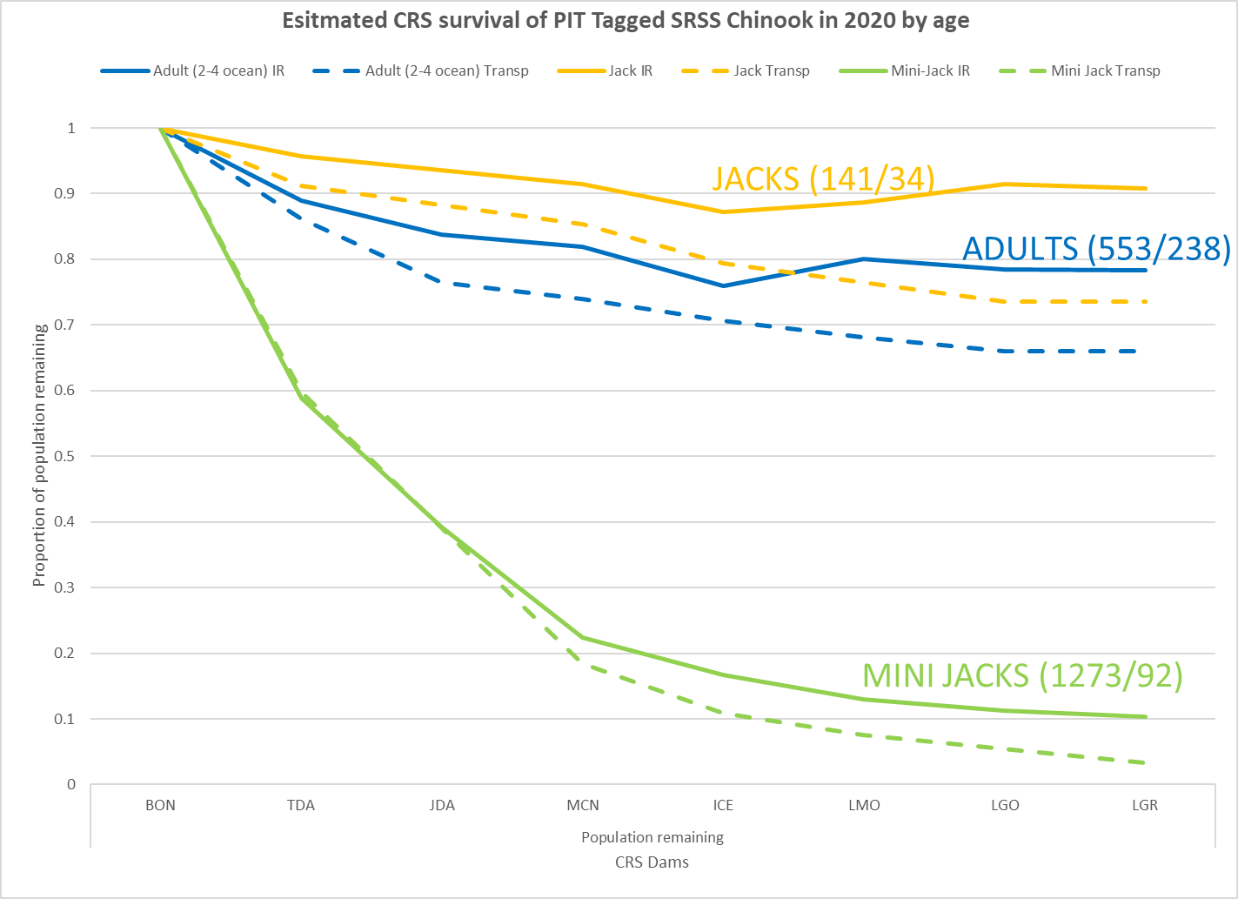
Differences in Survival by age
Not corrected for harvest or straying

Slide 11
Conversion analysis
Upload Bonneville tag list to PTAGIS, query for all observations in year they were observed at Bonneville
Download list to Access database
Using queries assemble a CRS trace for each PIT tag in Bonneville list (beware of duplicate observations at upstream dams). Compile traces into number of fish observed at each ladder
Calculate reach survivals using binomial method

Slide 12
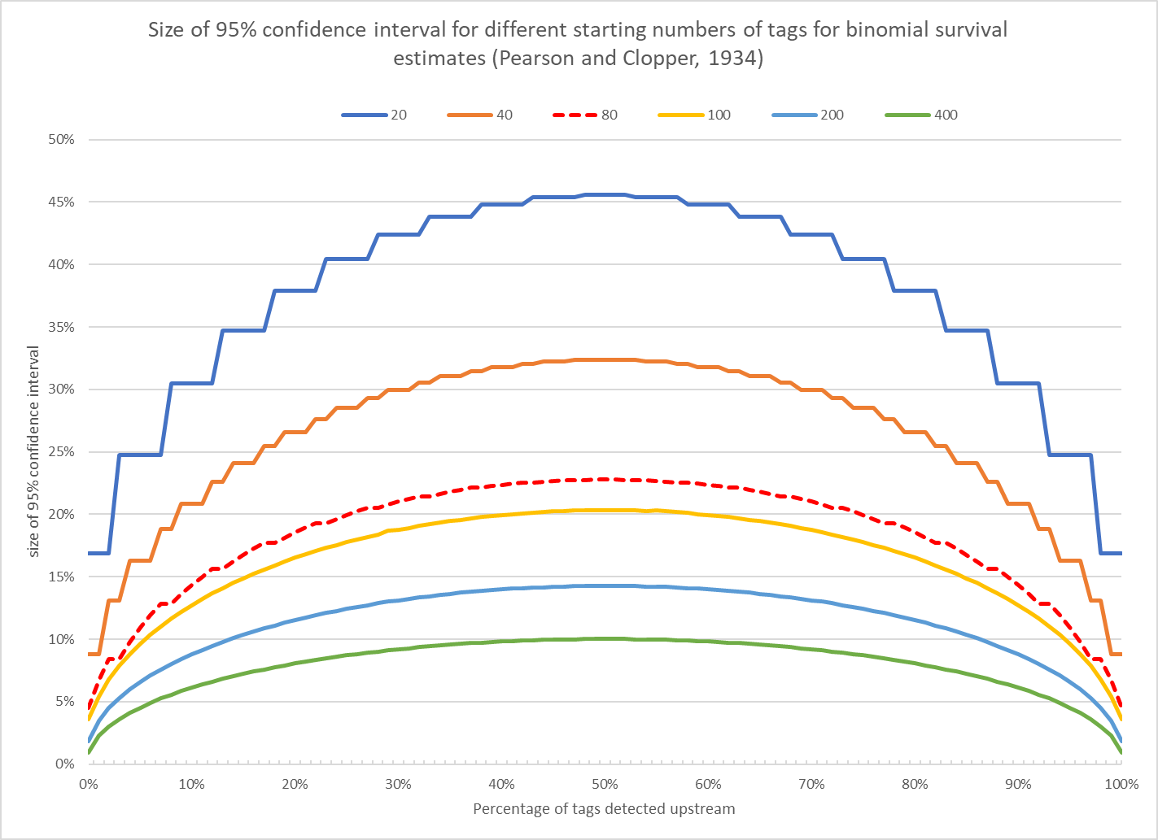
Sample Size considerations
Avoid using estimates < 40 tags

Slide 13
Reporting ESU, DPS and Reaches
BON to LGR, BON to MCN, MCN to LGR
Snake River Spring/Summer Chinook (IR/TR)
Snake River Steelhead (IR/TR)
Snake River Fall Chinook (IR/TR)
Snake River Steelhead(IR/TR)
Snake River Sockeye
BON to MCN
Upper Columbia Spring Chinook
Upper Columbia Steelhead
Middle Columbia Steelhead

Slide 14
Reporting Spreadsheet
Snake River Spring Summer
Chinook

Slide 15
CORRECTIONS
Applied to raw survival/conversion estimate to account for known causes of mortality
Harvest- Harvest % for BON to MCN and MCN to LGR reaches from TAC annual reports
Straying- Standard percentage applied from study: M.L. Keefer, C.A. Peery, J. Firehammer, and M.L. Moser. 2005 Straying Rates of known-origin adult Chinook salmon and steelhead within the Columbia River basin, 2000-2003. Technical Report 2005-5.

Slide 16
Other issues
A significant number of SR Steelhead do not cross LGR until the spring after the year they were observed at LGR (assigned spawn year-1)
Before 2010 and 2018-2020 insufficient PIT tagged SR Sockeye were observed to make a reliable estimate. UC Sockeye were used as surrogates

Slide 17
Limitations
Survival estimate is an average for the entire migration period of the ESU/DPS
Is the sample representative of the ESU/DPS? Some populations or portions of the run may be under/over represented
Not enough tags to get a reliable estimate for small populations (use surrogates?)
No plan to assure all groups of interest are tagged at rates to provide reliable adult survival estimates (we take what shows up)

Slide 18

Other methodologies/options
Cormak, Jolly, Seber (CJS) methodology (currently used for juvenile estimates)
DART Conversion Rate tool
PITTag Pro and SURPH software (DART)

Slide 19
Acknowledgements
PTAGIS
Northwest Fisheries Science Center
Columbia Basin Research/DART
Charlie Paulsen
Everyone conducting PIT tagging operations in Columbia River Basin

Slide 20
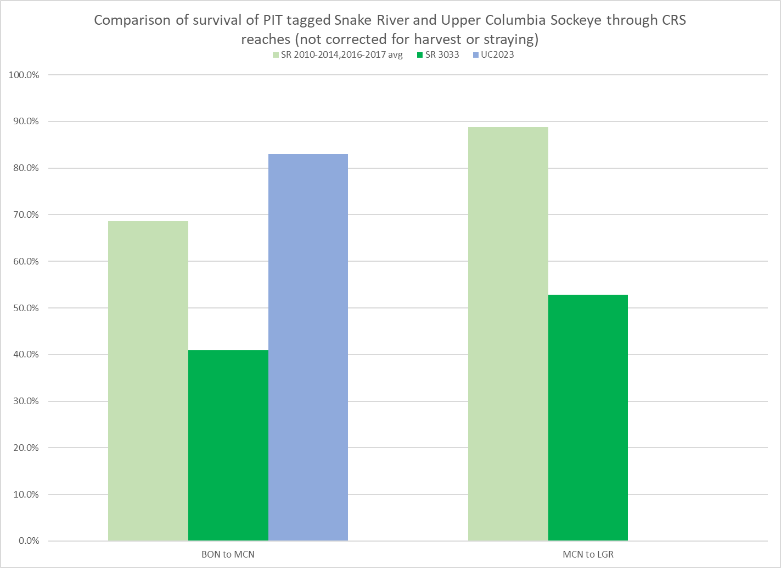
Preliminary analysis of 2023 Sockeye survival

Slide 21
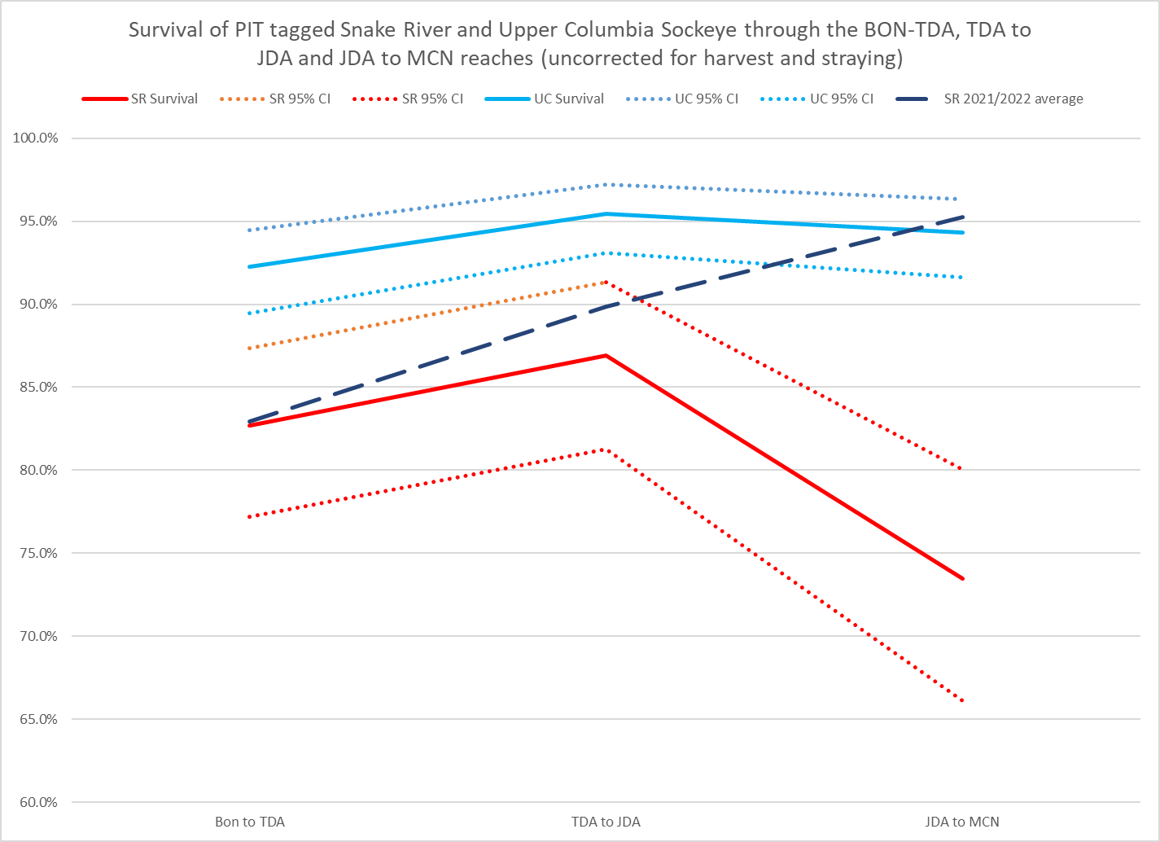
Preliminary analysis of 2023 Sockeye survival

